Slide 1
Information Storage and Retrieval Project
By Zo Di Santo and Jason Cardona

Slide 2



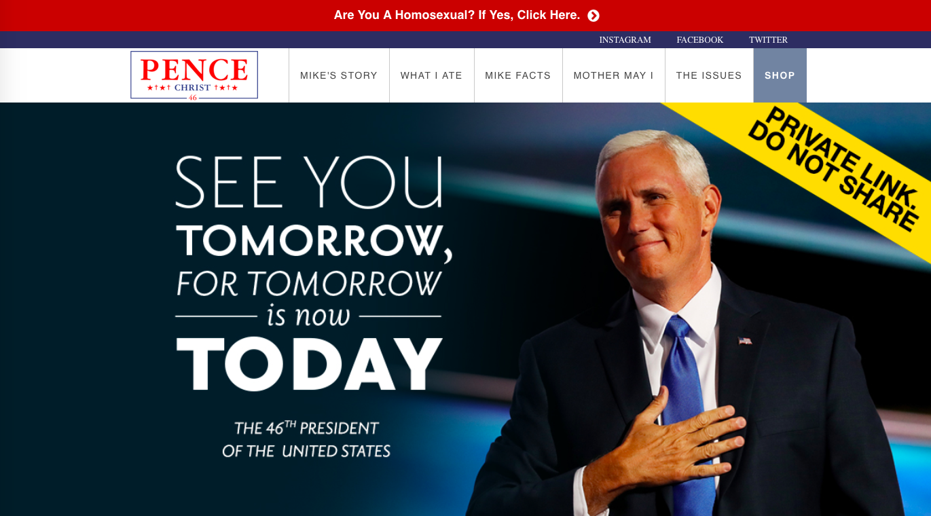
Search Problems
z
We took a spoof website and that it didn’t have a search bar, and we wanted to implement it into the website.

Slide 3
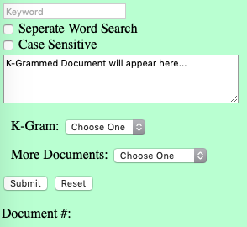
System Concept
z
Keyword: User Query
Separate Word Search: Select if user wants to search more than one word.
Case Sensitive: Select if user wants the query to be case sensitive.
K-gram: select bi-gram, tri-gram… any k-gram the user wants the search to utilize and this will show up in the text box above.
More Documents: Shows all documents, the first 5 or the last 5.
Document #: Shows which documents the query shows up in.
Notes:
We used JavaScript, HTML and CSS.

Slide 4
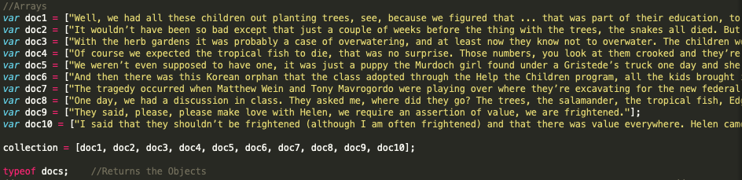
What Worked
z
We were able to index our documents, get the query and show the documents in which the query was in. We are also able to normalize the query. Taking out all punctuation and remove capitalizations.

Slide 5
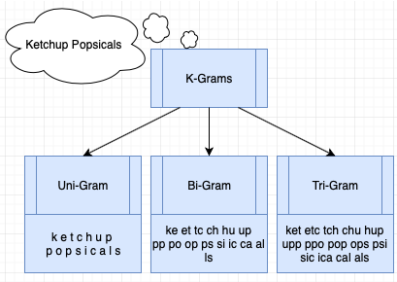
What Didn’t
z
We were not able to completely add a Spell Check functionality, tokenize, k-gram or have wildcards in our program.

